Slide 1

KHAIRUL SADMAN FARABI
ID-20304016
“Achievements & Contributions of Ayman Sadiq”

Slide 2
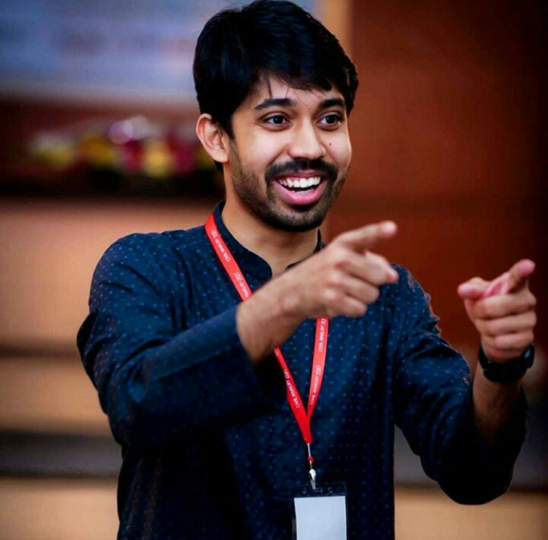
Ayman Sadiq
Ayman Sadiq is a passionate educator and founder of the 10 Minute School.
Ayman’s 10 Minute School is sponsored by Robi and supported by Govt. Bangladesh.
Best e-learning award from the Asia pacific ICT Alliance.
He has made education easier for students.

Slide 3
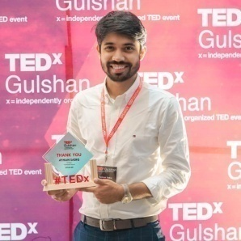





Key Achievements
Forbes 30 under 30
Forbes awards are given to the people who created an impact on nation or society
Ayman
Queens Young Leader Award
Sadiq
Queens young leaders award is given the most promising leaders.
Teacher | Author | Entrepreneur
Unilever Future Leaders League
Unilever’s future leaders league is a dynamic marketing competition.

Slide 4



10 MINUTE SCHOOL & AYMAN SADIQ
Teaching 150,000 students at free of cost
Equipping us with future skills
Giving free online notes

Slide 5

Where Ever You Are You Can Learn Anything With 10ms
DHAKA
KHULNA
SYLHET
RAJSHAHI
JESSORE
CHITTAGONG

Slide 6


Contribution for the underprivileged
The money he earned by selling the books usually he donates it to the poor children.
He goes to the places where there is no internet and teach them useful and interesting things

Slide 7
Tahsin Tanim Ramisha
20101439

Slide 8


Ay
Winner – DYDF Youth Icon Award ’16
Winner – Youth Award ’16
Winner – BRAC Manthan Digital Innovation Award ’16
Champion – BIZMAESTROS ’15 (UNILEVER)
Winner – Swiss Embassy Award for Social Impact ’16
Ayman Sadiq’s National awards
Champion – BRANDWITZ ’13 (IBA)
Winner - ISCEA PTAK Supply Chain Competition 2014

Slide 9
Tahfim Ur Rahman
20304002
Innovation And Creativity

Slide 10

10 minute school
Ayman Sadiq - founder and CEO of 10 minute school (2015).
The Largest Online Education Platform
Everday 250,000 student use 10MS free of costs
Students learn and practice from tutorials
Monitor their progress,
Compare with their peers
Gather information that is otherwise unavailable on the internet

Slide 11



Educational Books
Best seller books
2018
2020
2019

Slide 12
Some Interesting Facts About Ayman Sadiq
Shadab Iqbal
19101072

Slide 13

Transition in Field of Study
Incentive behind 10 Minute School
Initial Investment
Team members
Self development of Ayman Sadiq

Slide 14
References
https://www.forbes.com
http://www.thedailystar.net
https://www.queensyoungleaders.com
https://www.rokomari.com
https://10minuteschool.com
https://www.observerbd.com

